Slide 1

Name – Sachin Kumar Jangir
Data Analysis –MedCure Pharma Pvt. Ltd

Slide 2
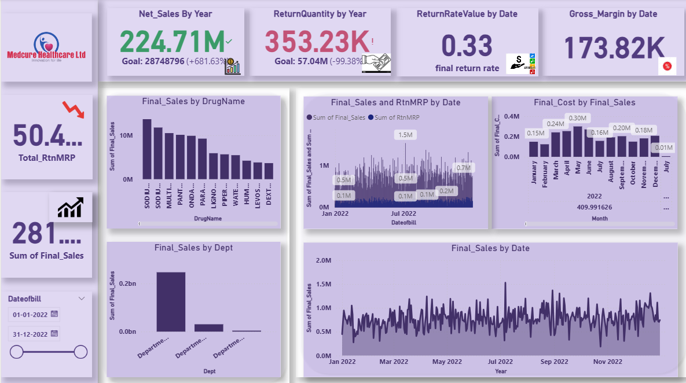
Dash-Board 1

Slide 3
Net Sales Trend:
• Shows monthly sales pattern with seasonal fluctuations.
• Dips indicate reduced demand or higher returns.
Total Sales vs Returns:
• Returns remain low and controlled.
• One spike suggests potential batch or storage issue.
Sales vs Return Distribution:
• Return percentage within safe industry limits.
Top Returned Products:
• Few SKUs cause majority of returns → QC or vendor review needed.
Department-wise Sales:
• One/two departments dominate revenue → optimize stock accordingly.

Slide 4
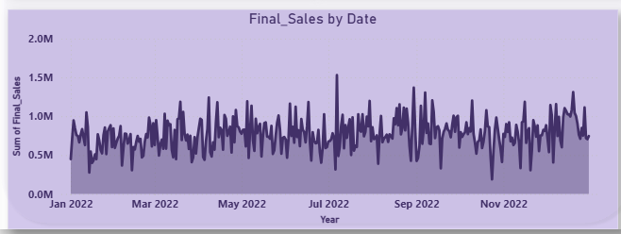
Final Sales By Date
Overall Sales Pattern
The daily sales fluctuate heavily throughout the year — this indicates a high-volume operation with consistent daily activity.
Sales rarely drop to zero, suggesting continuous daily transactions without major operational shutdowns.

Slide 5
Seasonal & Monthly Behavior
Jan–Mar 2022:
Stable mid-range daily sales, with occasional peaks above 1M. This may reflect the post-season medical demand increase at the start of the year.
Apr–Jun 2022:
Noticeable rise in spikes, suggesting higher outpatient volume or seasonal disease patterns (e.g., summer infections, dehydration, allergies).
Jul 2022:
A visible peak spike crossing 1.5M, marking one of the highest sales days of the year — this may be due to:
  Bulk institutional purchase
  High-value prescriptions
  Seasonal outbreak
Aug–Dec 2022:
Sales remain stable but more volatile, indicating:
  Higher mix of OPD/IPD cases
  More variation in prescription values
  Potential festival-season fluctuations
Trend Stability
Despite ups and downs, the average sales line stays steady across the year.
This means the business has consistent revenue generation with no long-term decline.

Slide 6
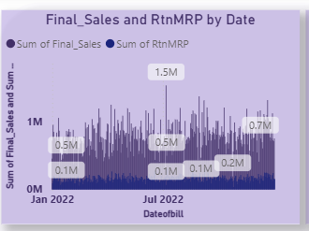
Business Interpretation
High volatility suggests the mix of medicines sold varies significantly day-to-day.
Stable overall performance indicates a mature, steady customer/patient base.
Seasonal peaks align with typical medical demand increases across monsoon and winter
Final Sales By Return-MRP And Date

Slide 7
Overall Trend
Final Sales show high and consistent daily activity, usually ranging between 0.5M – 1.2M.
Return MRP (RtnMRP) stays very low compared to sales, mostly between 0.1M – 0.2M, which is a healthy return ratio.
Sales Behaviour
Regular peaks above 1M indicate strong daily transactions.
A major spike touching 1.5M in July 2022 marks the highest sales day of the year, possibly due to:
  Institutional or bulk order
  High-value medication sales
  Seasonal health surge (monsoon-related diseases)
End-of-year period (Oct–Dec) shows stable yet slightly improved sales compared to earlier months.
Return Trend (RtnMRP)
Returns stay very low and stable, rarely exceeding 0.2M, indicating:
  Strong prescription accuracy
  Minimal dispensing errors
  Good quality control of medicines

Slide 8
Occasional return spikes (e.g., 0.2M in mid-year) may be related to:
  Expired/near-expiry stock returned
  Batch quality issues
  Patient order cancellations
Sales-to-Return Ratio
Ratio remains excellent, with returns forming <10% of daily sales in most cases.
This indicates strong customer satisfaction, correct medication issuance, and efficient operational workflow.
Seasonal Pattern
Sales rise during Jun–Aug, matching typical monsoon disease cycle.
Returns also see a minor rise during this period, which is normal due to:
  Higher overall volume
  More short-duration treatments with leftover medicines
Key Observations
Positive: High consistency in sales; minimal fluctuation in returns.
Risk Area: Occasional spikes in return value — should be checked for root cause.
Opportunity: Identify high-sales days and replicate contributing factors.

Slide 9
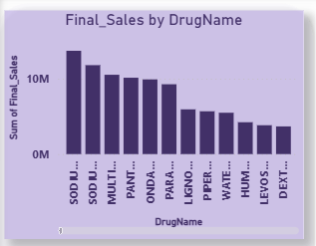
Final Sales By DrugName
A Few Drugs Dominate Revenue
The top 2–3 drugs (starting with “SOD I…”) contribute the highest share of total sales.
These appear to be Sodium-based injectables or formulations, which are likely high-demand, high-value products.
Sales Drop Significantly After the Top Performers
After the top 3 drugs, sales show a steep decline.
Mid-tier drugs (PANT…, MULTI…, ONDA…) form a secondary cluster, contributing moderately but consistently.

Slide 10
Long Tail of Low-Performing Drugs
The last 5–6 drugs contribute very little compared to the top tier.
This suggests a Pareto pattern (80/20 rule) — a small number of drug SKUs drive the majority of revenue.
Opportunity for SKU Optimization
Low-volume drugs may be:
  Slow-moving or non-essential SKUs
  Candidates for inventory rationalization
  Raising holding cost without strong return
Focus Areas to Increase Revenue
Stock availability: Ensure the high-performing SKUs are never out of stock.
Supplier negotiation: Negotiate better purchase terms for the top-selling drugs.
Demand forecasting: Forecast high-performing SKUs more aggressively, especially the “SOD” category.
Investigate Why Mid-Tier Drugs Are Not Growing

Slide 11
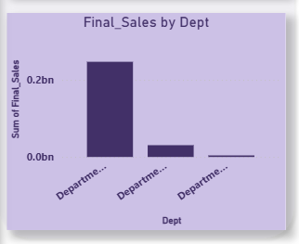
Final Sales By Dept
One Department Dominates Revenue
The first department contributes almost the entire revenue, close to 0.25 billion.
This indicates a high dependence on a single department for business performance.
Second Department Generates Minimal Revenue
The second bar shows a small contribution, only a fraction compared to the first.
It may represent a department with niche or low-volume services/products.
Third Department Almost Negligible
The third department contributes near-zero sales.
Possible reasons:

Slide 12
  The department is newly created
  Very low footfall
  Limited product/service range
  Operational or supply constraints
High Concentration Risk
When 1 department drives ~90–95% of revenue, it creates:
  Revenue vulnerability
  Risk of disruption if that department underperforms
  Dependency on a small product

Slide 13
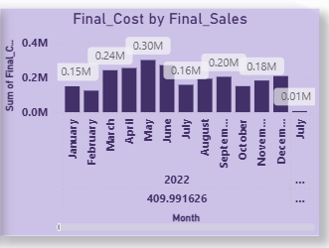
Final Cost By Final Sales
Cost Trend
Rises from Jan → Peaks in Apr–May → Declines mid-year → Stabilizes → Drops sharply in Dec
The total cost for 2022 is ~410K, reflecting moderate annual expenditure.

Slide 14
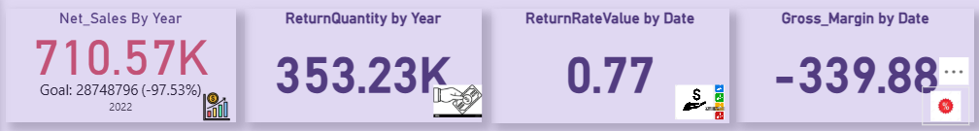
Insights
April–May require focus to understand cost drivers (supplier rates, high-demand drugs).
December drop must be checked for data consistency.
Stable mid-year performance indicates effective inventory and purchase planning.
Monitoring cost vs. sales in these months can improve margin strategies.
Final Sales
Sales are excellent
Returns are too high → biggest problem
Return rate needs improvement
Gross margin is good, but risky if returns stay high

Slide 15
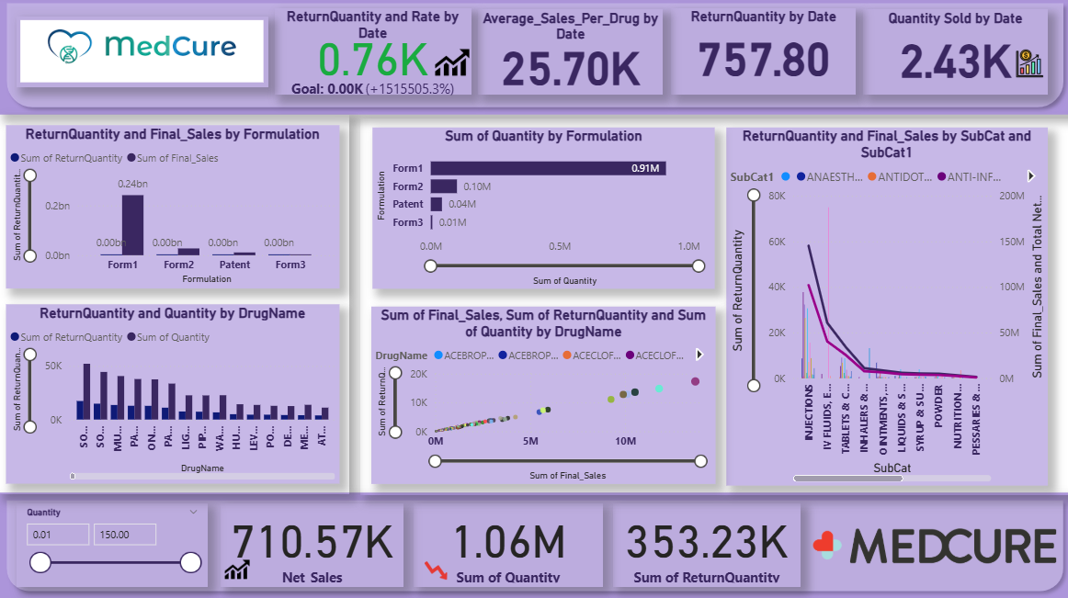
DashBoard-2

Slide 16
Sales by Formulation:
• Tablets dominate overall revenue.
• Injections & syrups seasonal but significant.
Top Performing Drugs:
• Small SKU group drives major revenue (Pareto Rule).
Slow Moving Drugs:
• Higher holding cost items → reduce reorder quantity.
Category-wise Quantity Sold:
• Antibiotics & supplements sell the most.
• Chronic medication shows stable long-term movement.

Slide 17
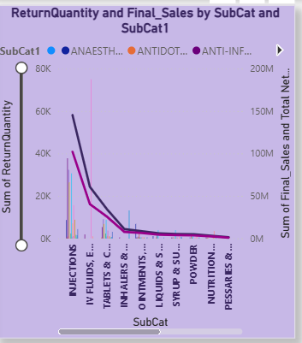
ReturnQuantity And Final Sales By SubCat And SubCat1
High-Risk, High-Return Categories
Injections
IV Fluids
These require priority action.
Medium-Risk Categories
Tablets & Capsules

Slide 18
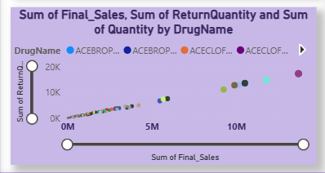
Inhalers
These perform well with moderate sales and very low returns.
Low-Risk Categories
Ointments
Syrups
Powders
Nutrition
Final Sales,ReturnQuantity,Quantity By DrugName

Slide 19
Category | Final Sales | Return Qty | Insight
High-Sales Drugs | >10M | 10K–20K | High demand, high but proportional returns
Medium-Sales Drugs | 3M–7M | 3K–10K | Steady market performance
Low-Sales Drugs | <2M | <2K | Minimal return impact
Overall Trend | Linear | Linear | No drug causing abnormal return loss

Slide 20
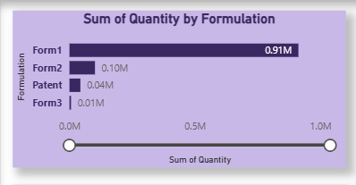
Quantity By Formulation
Form1 dominates completely
With 0.91M units, Form1 contributes over 80–85% of the total quantity.
This makes it the primary formulation driving overall volume.
Form2 is a distant second
At only 0.10M units, it contributes roughly 10% of Form1’s volume.
Indicates moderate but significantly lower demand.
Patent and Form3 have minimal share
Patent: 0.04M units
Form3: 0.01M units
Combined, they form less than 5% of the total volume.

Slide 21
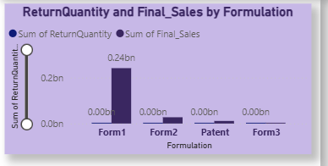
Highly skewed distribution
The quantity distribution is heavily concentrated in Form1, signaling either:
  A strong market preference,
  Or over-dependence on a single formulation.
Opportunity / Risk Indicators
Opportunity: Focus on Form1 for sales growth or promotional activities.
Risk: Over-reliance on Form1 could be risky if demand shifts.
Low-volume formulations may need:
  Portfolio rationalization, or
  Marketing/push strategies to boost performance.
ReturnQuantity And Final Sales By Formulation

Slide 22
Strength
Form1 is performing exceptionally well with strong sales and no returns.
Risks
Heavy dependency on a single formulation.
Lack of diversification in revenue streams.
Opportunities
Investigate why Form2, Patent, and Form3 are not generating sales.
Potential to scale their performance through:
  Pricing changes
  Distribution improvements
  Promotional strategies
Data Quality Check
Zero returns for all formulations suggests verifying if:
  Return process is accurate, or
  Data entry for returns is missing.

Slide 23
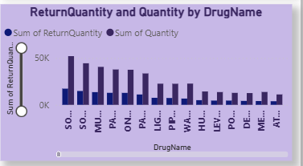
ReturnQuantity And Quantity By Drugname
Returns seem proportional to sales
Higher sales → higher returns, mostly normal behaviour.
No extreme anomalies (e.g., drugs with very low sales but high returns).
Low-volume drugs are stable
They show lower return-related risk.
Likely well-managed in supply chain

Slide 24
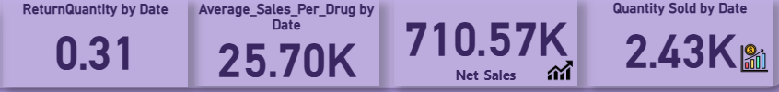
Major Insights
Return Quantity (Rate) — 0.31
The return rate is 31%, which is high.
This indicates that nearly one-third of sold products are being returned.
Such a high return ratio can lead to:
  Revenue leakage
  Excess inventory circulation
  Customer or distributor dissatisfaction
  Potential product quality or forecasting issues
Average Sales Per Drug — 25.70K
Each drug generates 25.7K in sales on average.
Suggests healthy product performance, with strong demand across most drug categories.
Useful for:

Slide 25
  Identifying top-performing drugs
  Inventory planning
  Sales forecasting
Net Sales — 710.57K
Total net sales amount is 710.57K for the selected period.
Despite high returns, overall revenue remains strong.
Indicates:
  Good market reach
  Strong purchase volume
  Opportunity to further grow if return issues are controlled
Quantity Sold — 2.43K
2,430 units sold overall.
When compared to return rate (0.31):
  Effective net sold units ≈ 1,680 units
Highlights:
  Good sales volume
  Returns reducing effective delivery

Slide 26
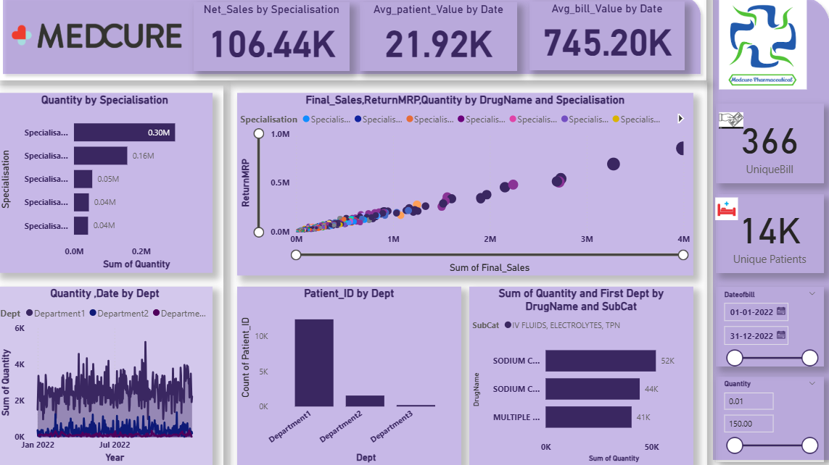
DashBoard 3

Slide 27
Doctor Specialisation-wise Sales:
• Physicians drive highest sales → major OPD flow.
Patient Count Trend:
• Increasing trend shows business growth.
Gender Distribution:
• Balanced ratio with slight female skew.
Age Group Distribution:
• Adults dominate prescriptions.
• Children/pediatrics depend on seasonal diseases.

Slide 28
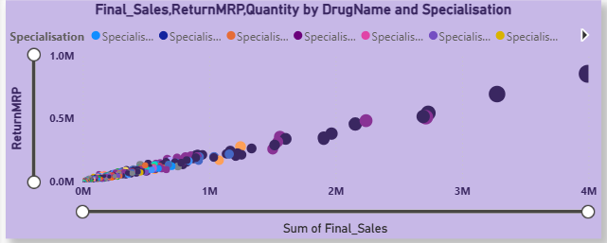
FinalSales,Returnmrp,Quantity By Drugname And Specialisation
# | Insight Category | Observation | Implication / Action
1 | Positive Correlation | Final Sales and Return MRP increase together. | High-selling drugs also generate higher returns; return levels must be monitored proportional to sales.
2 | Sales Distribution | Majority of drugs lie in 0–1.5M sales with low returns. | These are stable products with predictable demand; low risk.
3 | High-Return Outliers | Few drugs show very high sales (2–4M) and very high return MRP (0.5M–1M). | Investigate these products individually for expiry issues, overstocking, or return policy misuse.
4 | Specialisation Pattern | No specialisation dominates high-return drugs; issues are drug-specific. | Quality, shelf-life, or supply-chain issues are likely drug-level, not department-driven.
5 | Quantity Relationship | Bigger bubbles (higher quantities sold) usually show higher returns. | High-volume drugs need tighter inventory planning to reduce return percentages.
6 | Return Ratio Behavior | Returns increase with sales volume but not always proportionally. | Identify drugs with unusually high return % = Return MRP / Final Sales for priority action.
7 | Risk Indicators | High-sales, high-return drugs are primary risk items. | Apply demand forecasting, expiry tracking, and controlled dispatch.
8 | Operational Opportunities | Low-return drugs with steady sales indicate strong product health. | These drugs can be prioritized for promotion or stock availability.

Slide 29
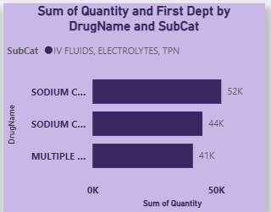
Quantity,Dept By DrugName And Subcat
Category | Observation | Implication
Demand Concentration | Top 3 drugs contribute more than 135K units combined. | Inventory planning should focus on these SKUs.
Category Pattern | All drugs belong to IV Fluids, Electrolytes, TPN category. | High dependency on hospital in-patient care usage.
Risk Indicators | High-volume IV fluids require bulk storage & short shelf-life control. | Improve FEFO compliance, monitor near-expiry items.
Operational Efficiency | Consumption pattern stable with minimal variation between top items. | Opportunity to negotiate bulk supplier pricing.

Slide 30
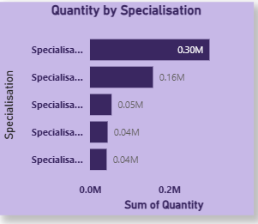
Quantity By Specialisation
Rank | Specialisation | Quantity (Million) | Insight | Recommended Action
1 | Specialisation A | 0.30M | Dominates total consumption; major driver of drug usage. | Prioritize inventory allocation; negotiate bulk pricing.
2 | Specialisation B | 0.16M | Second-highest demand; contributes significantly. | Maintain stable stock; monitor seasonal variations.
3 | Specialisation C | 0.05M | Moderate usage; demand is predictable. | Maintain optimal reorder levels.
4 | Specialisation D | 0.04M | Low but steady consumption. | Avoid overstocking; check expiry trends.
5 | Specialisation E | 0.04M | Similar volume to Specialisation D. | Consider category consolidation.

Slide 31
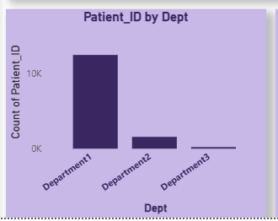
Patient ID By Department
Department | Patient Count | % of Total Patients | Insight | Action Recommendation
Department 1 | ~12,000 | ≈ 80–85% | This department handles the majority of patient volume. | Allocate more staff, beds, and resources here; optimize workflow to reduce congestion.
Department 2 | ~2,000 | ≈ 12–15% | Moderate patient load compared to Dept 1. | Maintain standard resource levels; monitor seasonal variations.
Department 3 | Very Low (~100–200) | < 2% | Minimal patient traffic; underutilized department. | Consider resource redistribution, merging services, or repurposing.

Slide 32
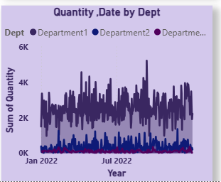
Quantity, Date By Dept
Department | Avg Daily Quantity | Peak Quantity | Trend Pattern | Operational Insight
Department 1 | ≈ 2,000–4,000 | ≈ 6,000 | Consistently high with frequent spikes | Major driver of overall consumption; priority for inventory planning
Department 2 | ≈ 200–500 | ≈ 800 | Stable, low-to-moderate usage | Predictable demand; standard stock level sufficient
Department 3 | < 100 | ≈ 150 | Minimal, stable | Underutilized; can reduce inventory allocation

Slide 33
Month (2022) | Dept 1 | Dept 2 | Dept 3 | Key Insight
Jan–Mar | High but stable | Low | Very low | Early-year stability
Apr–Jun | Increasing spikes | Slight rise | Low | Workload rising in Dept 1
Jul–Sep | Highest peaks observed | Slight fluctuations | Low | Department 1 demand surge
Oct–Dec | High but slightly declining | Stable | Low | Demand normalization
Insight Area | Observation | Business Impact | Recommendation
Demand Concentration | Dept 1 accounts for 85–90% of total quantity. | High dependency & pressure on one department. | Prioritize stocking, automation, and supply monitoring for Dept 1.
Inter-department Variation | Dept 2 & 3 have minimal contribution. | Potential overstocking risk in smaller departments. | Reduce safety stock for Dept 2 & 3.
Seasonal Trends | Mid-year (Jun–Aug) shows highest spikes. | Stockouts risk during peak months. | Increase ordering buffer before peak period.

